Slide 1


Synopsis Presentation on Gamified Learning Platform for Rural Education with AI Visual Conversion
Guided By: Presented By:
Internal Guide: Prashant Jagtap(0827IT231101)
Prof. Deepak Singh Chouhan Sarthik Yadav (0827IT231120)
Shreyansh Sharma (0827IT231130)
External Guide: Somil Jain (0827IT231135) Mr. Naman Jagtap

Slide 2
Contents
Introduction
1.1 Overview
1.2 Purpose
Literature Review
Problem Statement
Proposed Solution
Objectives
Theoretical Analysis
6.1 Block Diagram
6.2 Hardware Requirements
6.3 Software Requirements
Applications
REFERENCES

Slide 3
1. Introduction
1.1 Overview
1.2 Purpose
AI-powered platform that converts text-based study material into visual formats like diagrams, mind maps, and infographics.
Integrates gamification elements (quizzes, rewards, progress tracking) to make learning interactive and engaging.
Designed specifically to improve learning experiences for students in rural areas with limited resources.
Simplify complex educational content to improve understanding and retention.
Increase student motivation through interactive and game-based learning techniques.
Bridge the gap in quality education access by providing engaging and visual learning tools.

Slide 4
2. Literature Review
Sr. No. | Research Paper | Features | Drawbacks
1. | Gee, J. P. (2003). What Video Games Have to Teach Us About Learning and Literacy. Palgrave Macmillan. | Explains how games enhance active learning and student engagement. | Mainly conceptual with no technical system design.
2. | Mayer, R. E. (2009). Multimedia Learning (2nd Edition). Cambridge University Press. | Shows that combining text and visuals improves understanding and retention. | Lacks integration with modern AI-based learning systems.
3. | Deterding, S., Dixon, D., Khaled, R., & Nacke, L. (2011). From Game Design Elements to Gamefulness:DefiningGamification.Proceedi-ngs of the 15th International Academic MindTrek Conference. | Defines gamification using game elements like points and badges to increase engagement. | Mostly theoretical with limited real-world educational implementation.
4. | Devlin, J., Chang, M. W., Lee, K., & Toutanova, K. (2019). BERT: Pre-training of Deep Bidirectional Transformers for Language Understanding. NAACL Conference. | Powerful model for understanding and processing natural language effectively. | Requires high computational resources for use.
5. | Wolf, T., et al. (2020). Transformers: State-of-the-Art Natural Language Processing. EMNLP Conference. | Provides foundation for advanced NLP tasks like summarization and text generation. | Resource-intensive and not suitable for low-end systems.

Slide 5
3. Problem Statement
Problem 1: Lack of Engaging and Understandable Learning Content: Students in rural areas struggle to understand and retain information from traditional text-heavy study materials due to the absence of visual aids and simplified learning formats.
Problem 2: Low Motivation and Limited Interactive Learning Opportunities: The absence of gamified elements such as quizzes, rewards, and progress tracking leads to reduced student engagement and interest in learning, negatively impacting academic performance.

Slide 6
4. Proposed Solution
Rural students struggle with complex text-based learning, low engagement, and limited access to interactive tools. An AI-powered platform can simplify content into visuals, add quizzes and gamification, and support multilingual and offline learning.
Convert complex text into visual formats for better understanding.
Generate quizzes and interactive content automatically.
Use gamification (points, badges, leaderboards) to boost motivation.
Enable multilingual, voice-based, and offline learning access.

Slide 7
5. Objectives
Develop an AI system to convert text into visual learning formats.
Integrate gamification features to boost student engagement.
Provide multilingual and voice-based learning support.
Ensure accessibility with offline/low-connectivity functionality.

Slide 8
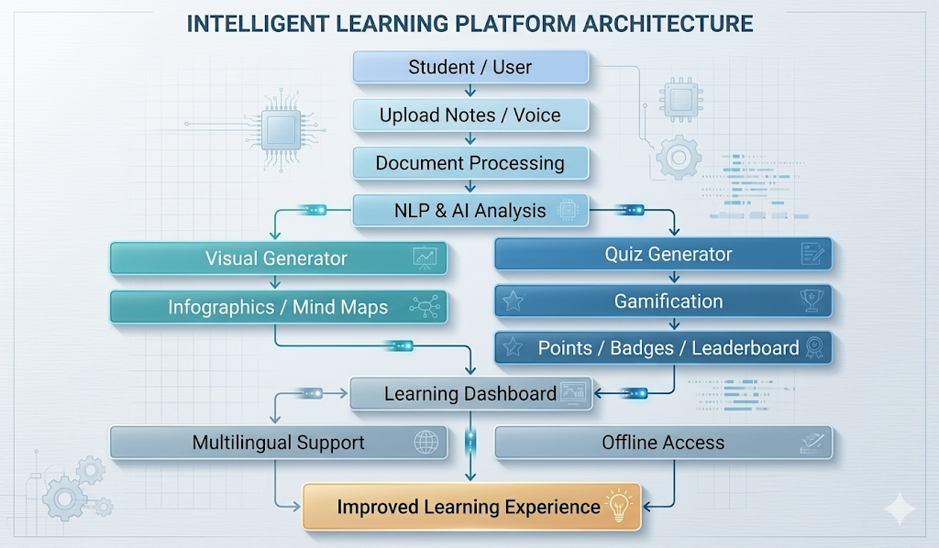
6. Theoretical Analysis
6.1 Block Diagram

Slide 9
6. Theoretical Analysis
6.2 Hardware Requirements:
Processor: Intel Core i5 or AMD Ryzen 5 (or higher) for smooth processing.
RAM: Minimum 8 GB for handling AI and visualization tasks.
Storage: At least 256 GB SSD for fast data access and storage.
Internet Device: Smartphone or laptop with webcam/camera support for input and interaction.
6.3 Software Requirements:
Programming Language: Python 3.8+ for AI and backend development.
AI/NLP Libraries: Hugging Face Transformers, NLTK, spaCy for text analysis and quiz generation.
Frameworks: Flask / Django (backend), Streamlit (UI for prototype).
Visualization Tools: Mermaid.js, D3.js for diagrams and mind maps.

Slide 10
7. Applications
Rural schools and educational institutions.
Self-learning platforms for students.
Government digital education initiatives.
Skill development and training programs.
Educational NGOs working in rural areas.
E-learning and online education platforms.
Adult education and literacy programs.

Slide 11
GitHub Link
https://github.com/.................................

Slide 12
REFERENCES
Deterding, S., Dixon, D., Khaled, R., & Nacke, L. (2011). From Game Design Elements to Gamefulness: Defining Gamification. Proceedings of the 15th International Academic MindTrek Conference.
Mayer, R. E. (2009). Multimedia Learning (2nd Edition). Cambridge University Press.
Devlin, J., Chang, M. W., Lee, K., & Toutanova, K. (2019). BERT: Pre-training of Deep Bidirectional Transformers for Language Understanding. NAACL Conference.
Gee, J. P. (2003). What Video Games Have to Teach Us About Learning and Literacy. Palgrave Macmillan.
Wolf, T., et al. (2020). Transformers: State-of-the-Art Natural Language Processing. EMNLP Conference.

Slide 13
~Thank You
Any Queries

